Slide 1

Web Application Development
COMP-229
Fall 2023

Slide 2
Introduction to MongoDB
Objectives:
Define NoSQL
Examine MongoDB's document model, query language, and deployment architecture
Work with MongoDB shell
Connect to MongoDB database using Mongoose

Slide 3
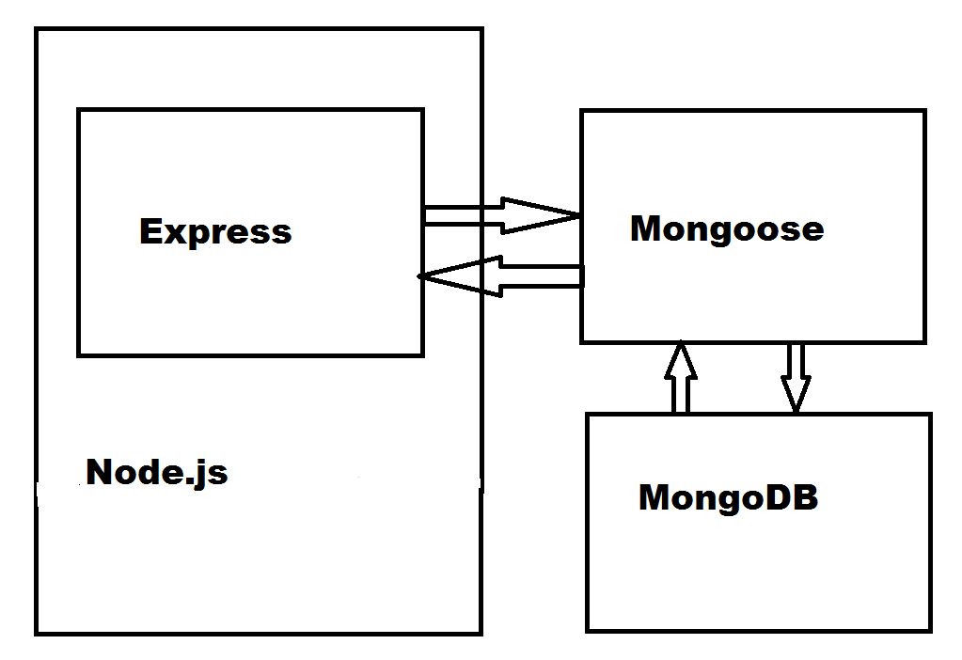
Adding MongoDB to Express app
Express application architecture including a MongoDB database:

Slide 4
Introduction to NoSQL
The growth of Web raised the need for larger, more scalable storage solutions.
a variety of key-value storage solutions were designed for better availability, simple querying, and horizontal scaling.
This new kind of data store became more and more robust, offering many of the features of the relational databases.
Different storage design patterns emerged, including key-value storage, column storage, object storage, and the most popular one, document storage.

Slide 5
Relational vs Document-oriented DB
In a common relational database, data is stored in different tables, often connected using a primary to foreign key relation.
A program will later reconstruct the model using various SQL statements to arrange the data in some kind of hierarchical object representation.
Document-oriented databases handle data differently.
Instead of using tables, they store hierarchical documents in standard formats, such as JSON and XML.

Slide 6
Relational DB example
blog post model – data stored in different tables:

Slide 7
Document-oriented DB example
In a document-based database, the blog post will be stored completely as a single document that can later be queried.
For instance, in a database that stores documents in a JSON format, the blog post document would probably look like the following code snippet:
{
"title": "First Blog Post",
"comments": [
]
}
This model will allow faster read operations since your application won't have to rebuild the objects with every read.

Slide 8
Intro to MongoDB
Created in 2007 by Dwight Merriman and Eliot Horowitz
Derived from the word humongous, MongoDB was able to support complex data storage, while maintaining the high-performance approach of other NoSQL stores.
eBay and The New York Times began to use MongoDB data storage in their production environment.

Slide 9
MongoDB Key features
JSON-like storage format named BSON (BinaryJSON) - a document consists of a list of elements, each with a string typed field name and a typed field value.
These documents support all of the JSON specific data types along with other data types, such as the Date type.
use of the _id field as primary key - The _id field value will usually be a unique identifier type, named ObjectId, that is either generated by the application driver or by the mongod service.
If driver fails to provide a _id field with a unique ObjectId, the mongod service will add it automatically.

Slide 10
BSON example
A BSON representation of the blog post object from the previous example would look like the following code snippet:
{
"_id": ObjectId("52d02240e4b01d67d71ad577"),
"title": "First Blog Post",
"comments": [
...
]
}

Slide 11
MongoDB ad hoc queries
MongoDB is able to run queries by indexing BSON documents and using a unique query language.
The following SQL statement example:
SELECT * FROM Posts WHERE Title LIKE '%mongo%';
Can be replicated in MongoDB as follows:
db.posts.find({ title:/mongo/ });
MongoDB is almost as query-able as your traditional relational database.

Slide 12
MongoDB indexing
An index maps document fields and can tell the engine which documents are compatible with the query statement.
For instance, we want to retrieve all the posts that have more than 10 comments and our document is defined as follows:
{
"_id": ObjectId("52d02240e4b01d67d71ad577"),
"title": "First Blog Post",
"comments": [
],
"commentsCount": 12
}
The MongoDB query that requests for documents with more than 10 comments would be as follows:
db.posts.find({ commentsCount: { $gt: 10 } });

Slide 13
MongoDB indexing
If a commentCount index was defined, then MongoDB would only have to check which documents have commentCount larger than 10, before retrieving these documents.
The following diagram illustrates how a commentCount index would work:

Slide 14
MongoDB replica set
Replication of databases helps protect your data to recover from hardware failure and increase read capacity.
A replica set is a set of MongoDB services that host the same dataset.
One service is used as the primary and the other services are called secondaries.
All of the set instances support read operations, but only the primary instance is in charge of write operations

Slide 15
MongoDB sharding
Scaling is a common problem with a growing web application.
The various approaches to solve this issue can be divided into two groups:
vertical scaling - increasing single machine resources
horizontal scaling - with multiple machines
MongoDB supports horizontal scaling, which it refers to as sharding

Slide 16
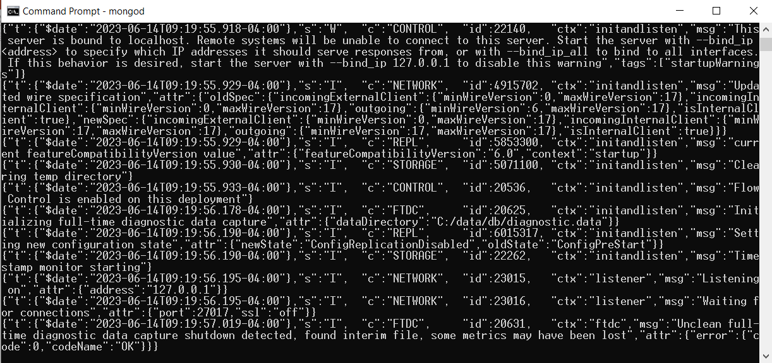
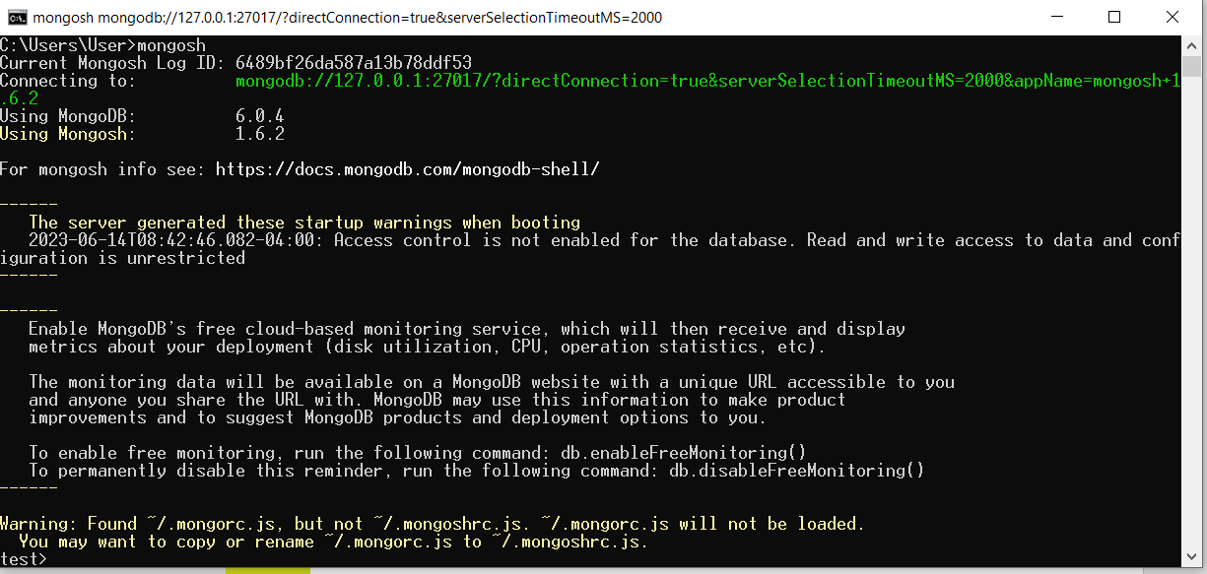
MongoDB shell
To interact with MongoDB, you'll use the MongoDB shell. First run mongod:
Then run mongosh:

Slide 17
Creating and showing databases
MongoDB shell will automatically connect to the default test database.
To switch to another database called mean by executing the following command:
use mean
To list all the other databases in the current MongoDB server, just execute the following command:
show dbs

Slide 18
MongoDB collections
A MongoDB collection is a list of MongoDB documents and is the equivalent of a relational database table.
A collection is created when the first document is being inserted.
Unlike a table, a collection doesn't enforce any type of schema and can host different structured documents.
Insert and retrieve example:
db.posts.insert({"title":"First Post", "user": "bob"})
db.posts.find()
Show all available collections:
show collections
To drop a collection: db.posts.drop()

Slide 19
MongoDB CRUD operations
Create a new document – use insert(), update(), or save() methods.
Read a document – use find() method.
Update a document - use update() or save() methods.
Deleting documents – use remove() method.

Slide 20
Creating a document using insert()
The most common way to create a new document is to use the insert() method.
The insert method takes a single argument that represents the new document.
To insert a new post, just issue the following command in the MongoDB shell:
db.posts.insert({"title":"Second Post", "user": "alice"})

Slide 21
Creating a document using update()
The update() method is usually used to update an existing document.
You can also use it to create a new document, if no document matches the query criteria, using the following upsert flag:
db.posts.update({"user":"alice"},{$set:{"title":"Second Post","user":"alice"}},{upsert:true})

Slide 22
Creating a document using insertOne() or replaceOne()
Another way of creating a new document is by calling the insertOne() method or replaceOne() method, passing it a document that either doesn't have an _id field or has an _id field that doesn't exist in the collection:
db.posts.insertOne({"title":"Second Post","user":"alice"})
This will have the same effect as the update() method and will create a new document instead of updating an existing one.

Slide 23
Finding all the collection documents
To retrieve all the documents in the posts collection, you should either pass an empty query to the find() method or not pass any arguments at all.
The following query will retrieve all the documents in the posts collection:
db.posts.find()
Furthermore, performing the same operation can also be done using the following query:
db.posts.find({})

Slide 24
Retrieve a specific document
Use an equality condition query that will grab all the documents, which comply with that condition.
For instance, to retrieve all the posts created by alice, you will need to issue the following command in the shell:
db.posts.find({ "user": "alice" })
This will retrieve all the documents that have the user property equal to alice.

Slide 25
Build more complex queries
Using query operators, you can look for different sorts of conditions.
For example, to retrieve all the posts that were created by either alice or bob, you can use the following $in operator:
db.posts.find({ "user": { $in: ["alice", "bob"] } })
Like in SQL, you can use AND/OR operators to build multiple condition query statements.
To perform an AND query, you simply add the properties you'd like to check to the query object.
For instance, take look at the following query:
db.posts.find({ "user": "alice", "commentsCount": { $gt: 10 } })

Slide 26
Build more complex queries
An OR query is a bit more complex because it involves the $or operator.
To understand it better, take a look at another version of the previous example:
db.posts.find( { $or: [{ "user": "alice" }, { "user": "bob" }] })
Like the query operators example, this query will also return all the posts created by either bob or alice.

Slide 27
Updating existing documents
The update() method takes three arguments to update existing documents:
the selection criteria that indicate which documents to update
the second argument is the update statement
The third argument is the options object.
db.posts.update({
"user": "alice"
}, {
$set: {
"title": "Second Post"
}
}, {
multi: true
})

Slide 28
Updating existing documents Contd.
Notice how the multi property has been added to the options object.
The update() method's default behavior is to update a single document, so by setting the multi property, you tell the update() method to update all the documents that comply with the selection criteria.

Slide 29
Updating documents using updateOne()
Another way of updating an existing document is by calling the updateOne() method, passing it a document that contains an _id field.
For instance, the following command will update an existing document with an _id field that is equal to ObjectId("65b4a6babd5faf31f5b30e3b"):
db.posts.updateOne( { "_id": ObjectId("65b4a6babd5faf31f5b30e3b") }, { $set: { "title": "Second Post", "user": "alice" } }, { upsert: true } )
It's important to remember that if the updateOne() method is unable to find an appropriate object, it will create a new one instead.

Slide 30
Deleting documents
To remove documents, you will need to use the remove() method.
The remove() method can accept up to two arguments.
The first argument is the deletion criteria
The second argument is a Boolean argument that indicates whether or not to remove multiple documents.

Slide 31
Deleting all documents
To remove all the documents from a collection, you will need to call the remove() method with no deletion criteria at all.
For example, to remove all the posts documents, you'll need to execute the following command:
> db.posts.remove({})
Notice that the remove() method is different from the drop() method, as it will not delete the collection or its indexes.
To rebuild your collection with different indexes, it is preferred that you use the drop() method.

Slide 32
Deleting multiple documents
To remove multiple documents that match a criteria from a collection, you will need to call the deleteMany() method with a deletion criteria.
For example, to remove all the posts made by alice, you'll need to execute the following command:
> db.posts.deleteMany({ "user": "alice" })
Note that this will remove all the documents created by alice, so be careful when using the deleteMany() method.

Slide 33
Deleting a single document
To remove a single document that matches a criteria from a collection, you will need to call the deleteOne() method with a deletion criteria and a Boolean stating that you only want to delete a single document.
For example, to remove the first post made by alice, you'll need to execute the following command:
> db.posts.deleteOne({ "user": "alice" }, true)
This will remove the first document that was created by alice and leave other documents even if they match the deletion criteria.

